Slide 1

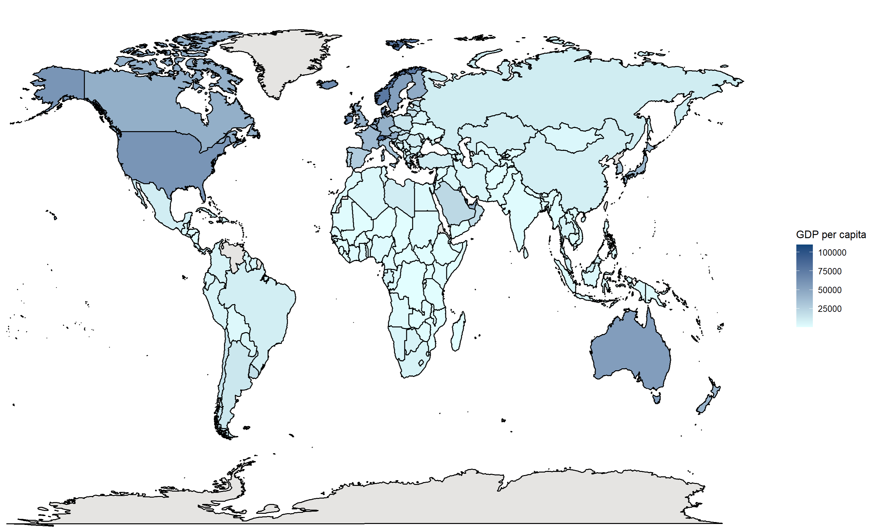
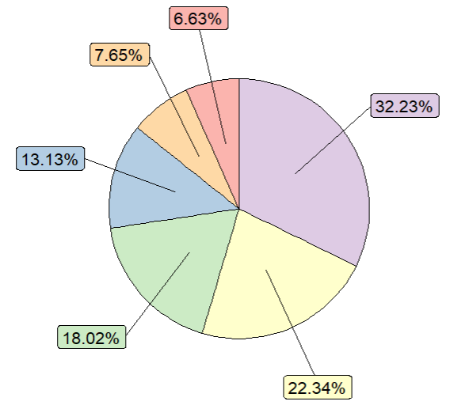
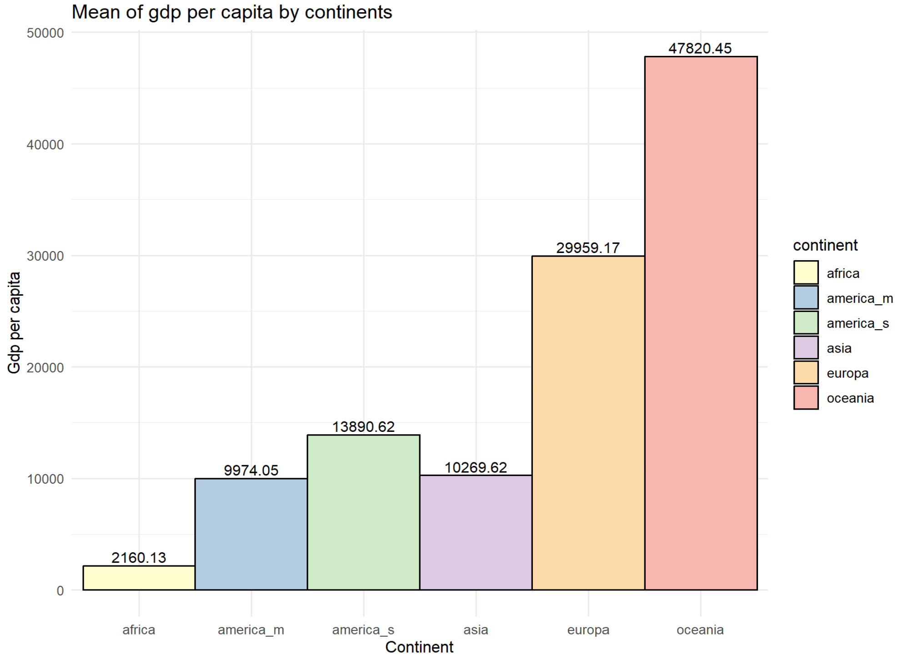
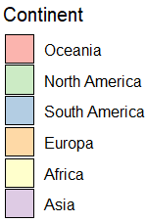
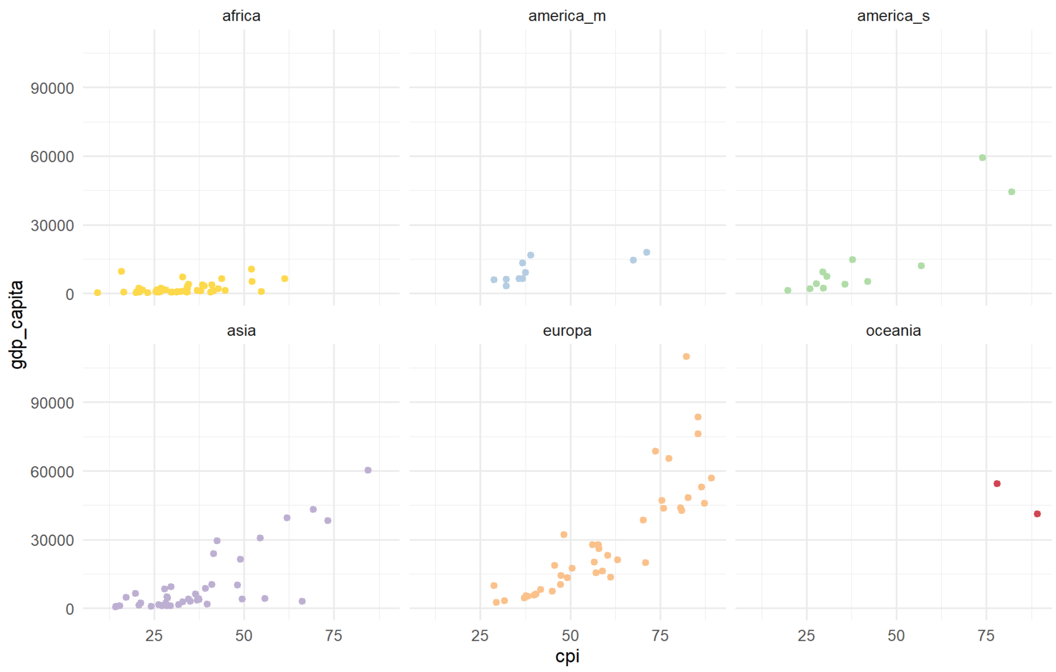
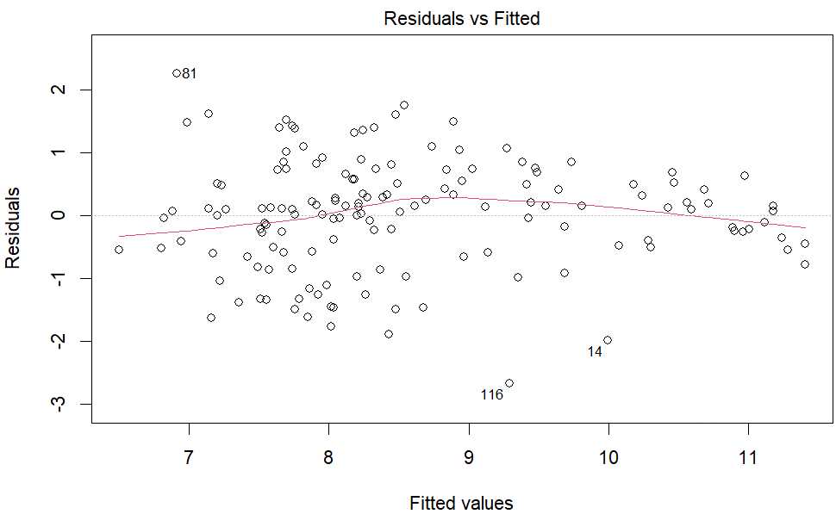
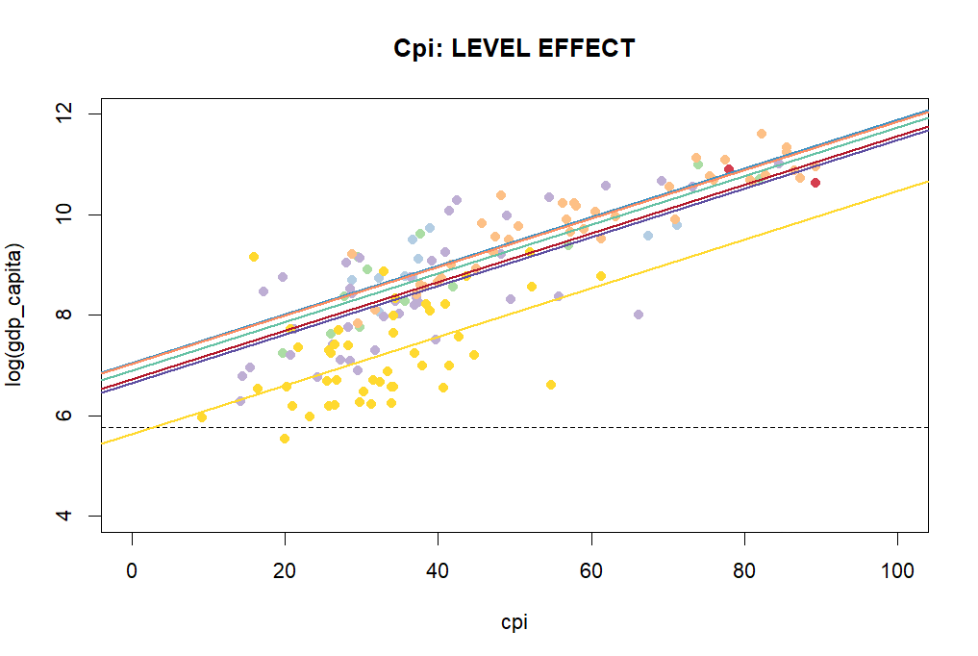
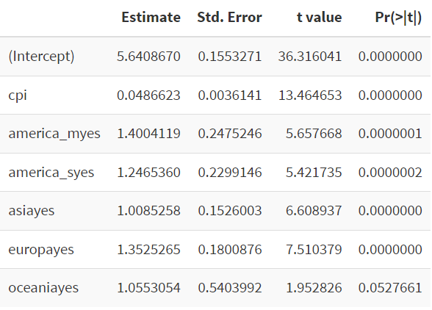
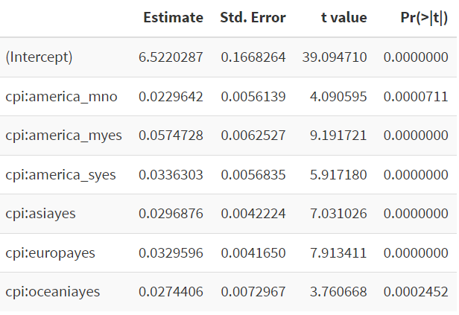
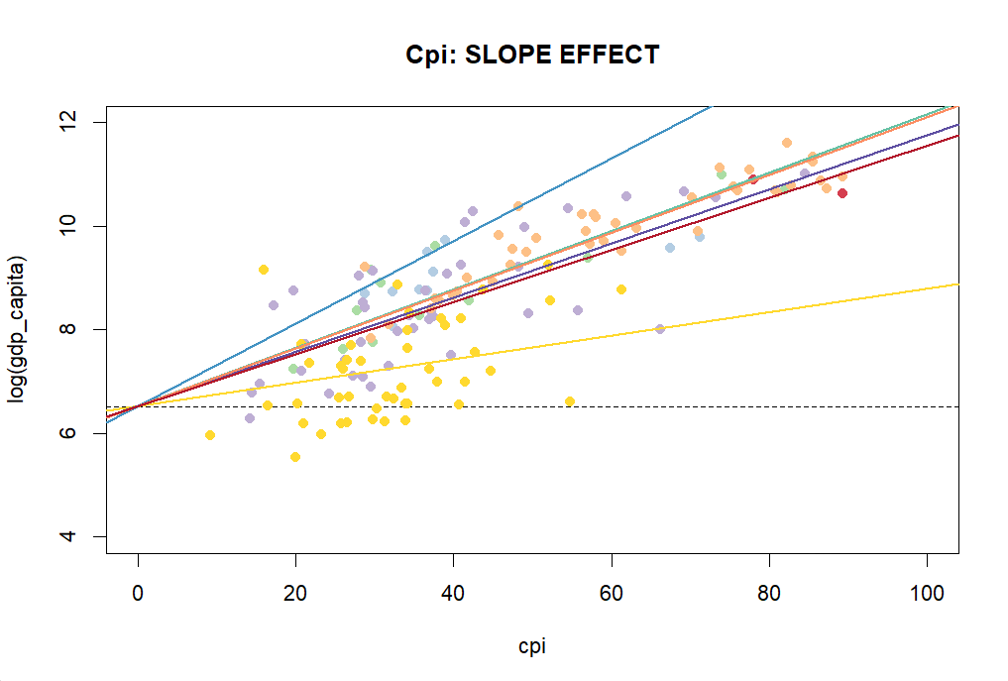
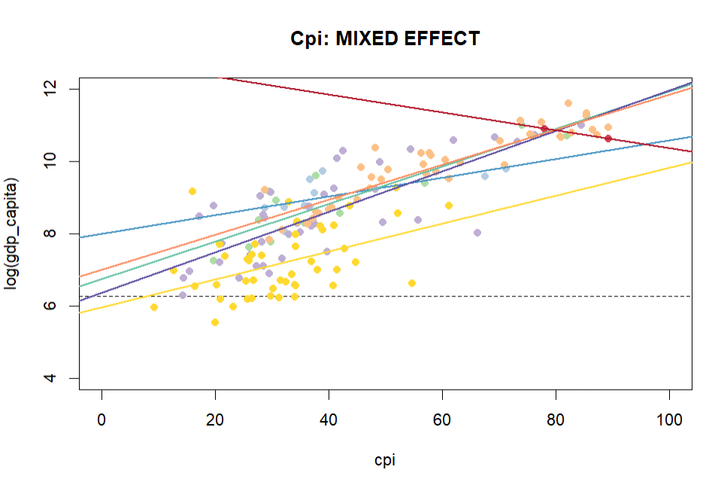
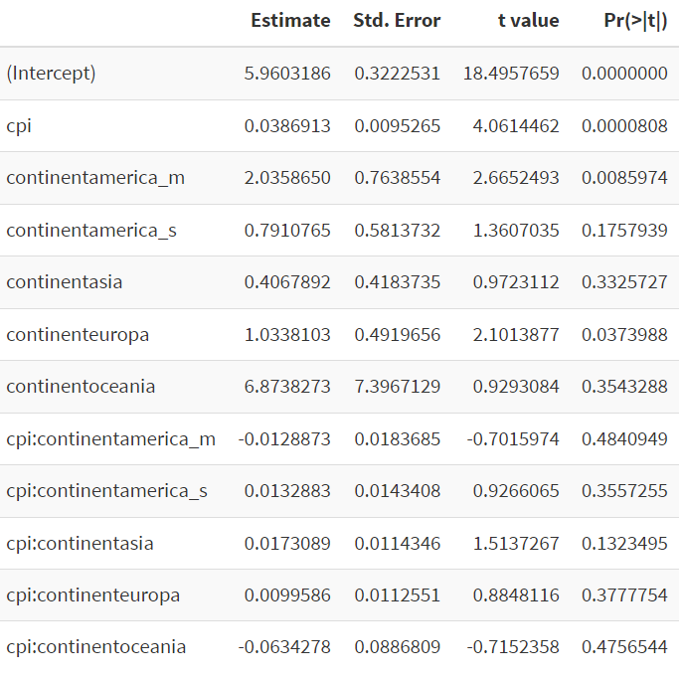
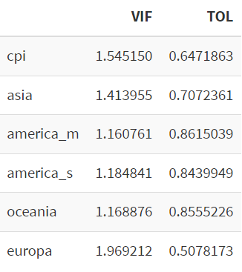
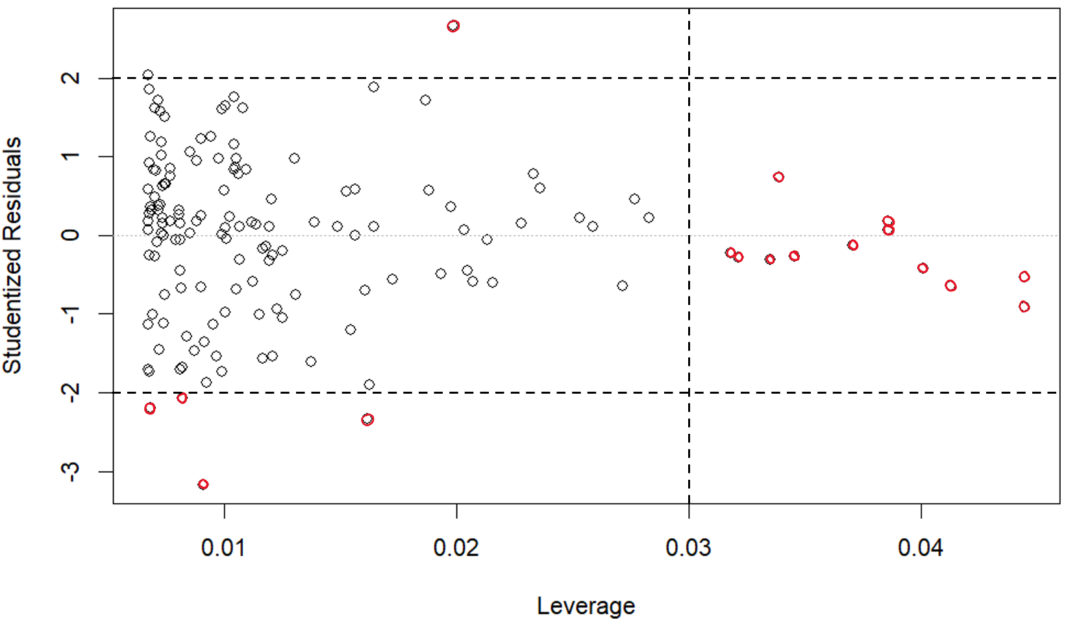









GDP per capita: the impact of CPI
WORLD MAP
This analysis is based on the GDP per capita in the world.
In the world there are six continents that have a different coverage.
The word map show us that the impact of the GDP per capita do not entirely depends on the dimension of the continent.
CONTINENTS COVERAGE
MEAN OF GDP PER CAPITA
RELATIONSHIP BETWEEN GDP PER CAPITA AND CPI ACROSS THE CONTINENTS
The left graph suggests that interaction terms are needed.
The right plot is obtained by applying the log transformation of Y, that makes the residual homoscedastic.
IMPACT OF CPI
$$\left(β_{0}+β_{j}\right)+β_{1}x$$
In the LEVEL EFFECT the dummy for each continents has an impact on the intercept, while the slope is the same.
The average effect of one unit increase of CPI on GDP per capita does not depend on the continents.
$$β_{0}+β_{1}x$$
$$R^{2} Adj$$
0.7749
In the SLOPE EFFECT the dummy for each continents has an impact on the slope, while the intercept is the same.
The average effect on GDP per capita of a one unit increase of CPI does depend on the continents.
$$β_{0}+{(β}_{1}+β_{j})x$$
$$R^{2} Adj$$
$$β_{0}+β_{1}x$$
0.767
$$\left(β_{0}+β_{j}\right)+{(β}_{1}+β_{j})x$$
In the MIXED EFFECT we have different regression lines for continent, where each line is characterized by a different intercept and a different slope.
$$β_{0}+β_{1}x$$
$$R^{2} Adj$$
MODEL DIAGNOSTIC
0.7754
CONCLUSION
VIF and TOL are computed for detecting eventual issue of the multicollinearity.
There are some high leverage points and outliers.
This analysis demonstrate that only the Slope Effect is statistically significant on our data.
The average effect on GDP per capita of a one unit increase of CPI does depend on the continents.
Statistical Learning, Prof. Monica Manisera, 2023/24

